Slide 1
Expeditor
Urban Food-Supply Marketplace and Delivery Optimization System
IFT 402 Paul Polsinelli

Slide 2
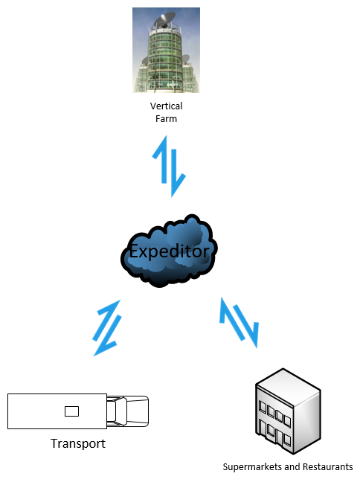
Fresh food, produced by indoor vertical farms, delivered to local markets with next to zero food waste, at minimal cost, with maximum fuel savings.
Expeditor

Slide 3

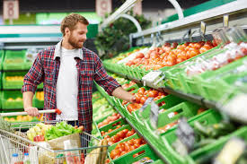
The Urban Stakeholders: Supermarkets, Restaurants, and their Customers

Slide 4
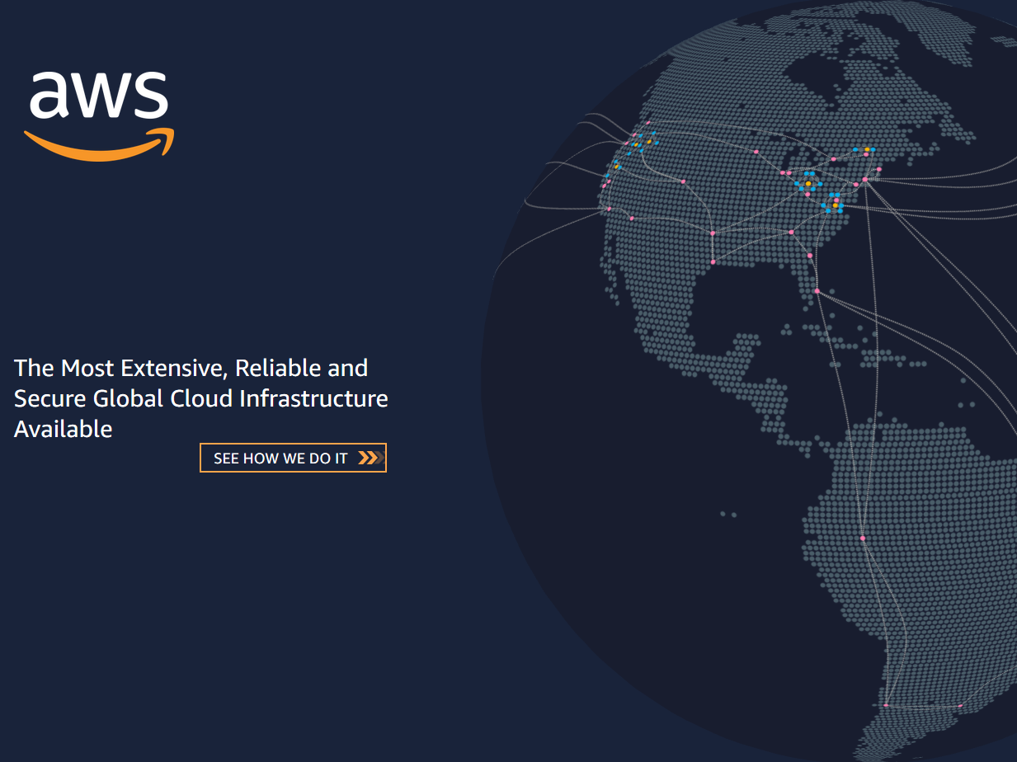
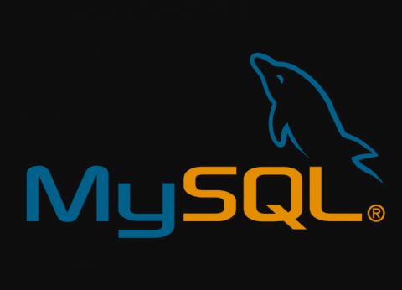
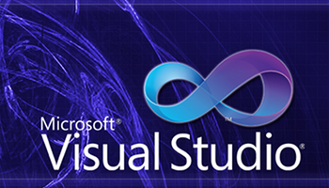
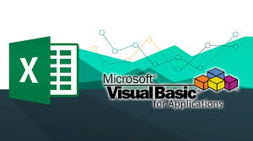






The Technology
Tensorflow
Keras
<html>
API REST framework
<CSS>
<javascript>

Slide 5
The Build
Some changes, or more aptly for the most part, additions, have been make to the Expeditor build since it began. Firstly, the topographical design has been simplified to include all its components onto one server, making it more a service than a distributed system. This simplifies build time and scalability in the real world.
The database design has also changed and is a developing system as it is being built piece by piece as tables are needed to reduce complexity and overbuilding.
Technologies have been added as the build has progressed and new understanding of the technology needs developed. Several solutions have been incorporated as previous assumptions of needs, processes, and software capabilities changed.

Slide 6
Accomplishments
Predictive AI script fully functional and outputs to DB
Database set up and connected to AI script and fully configured API framework
Custom API’s completely functional and integrated with DB and UI
Supermarket and Restaurant UI built
Distance matrix functional, populated, and integrated with Bing Maps API

Slide 7

Progress

Slide 8
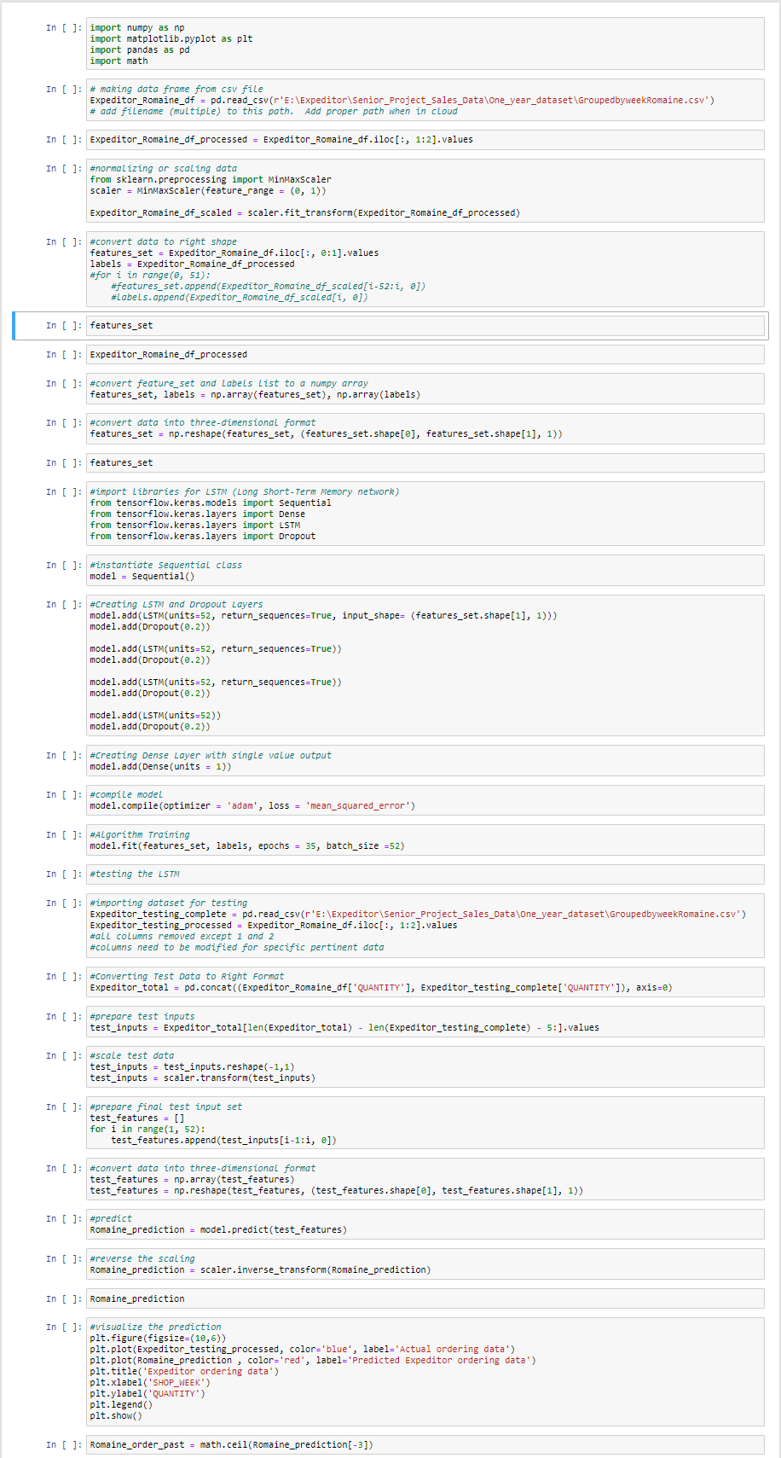
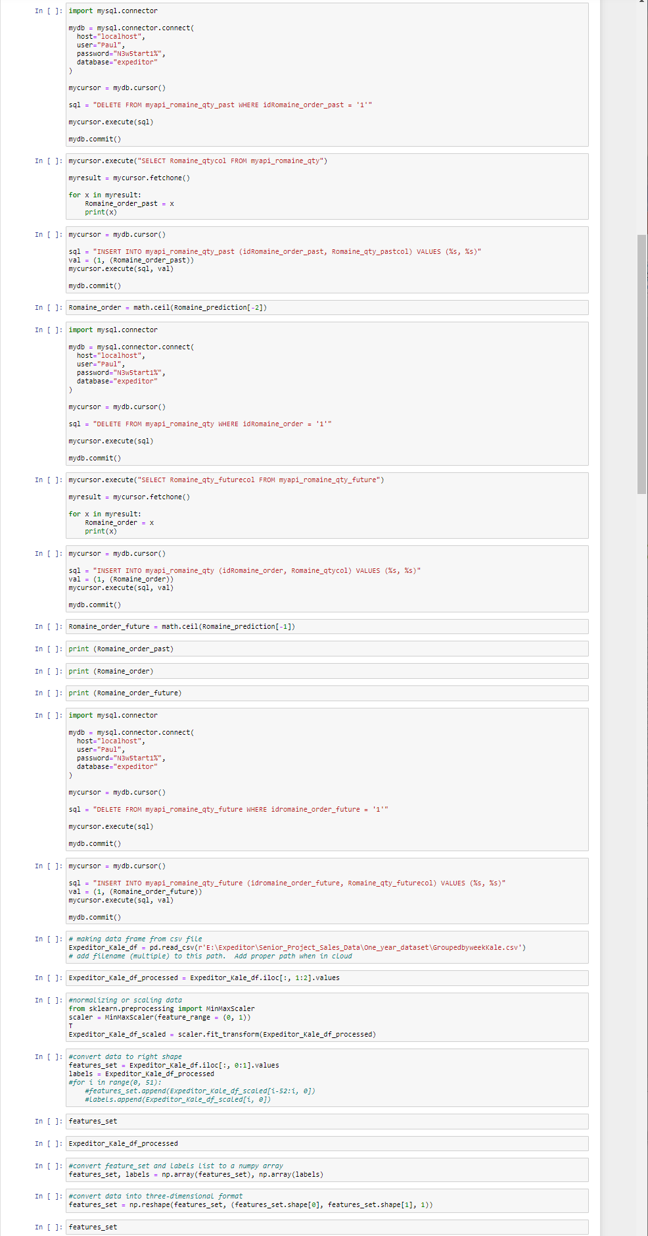
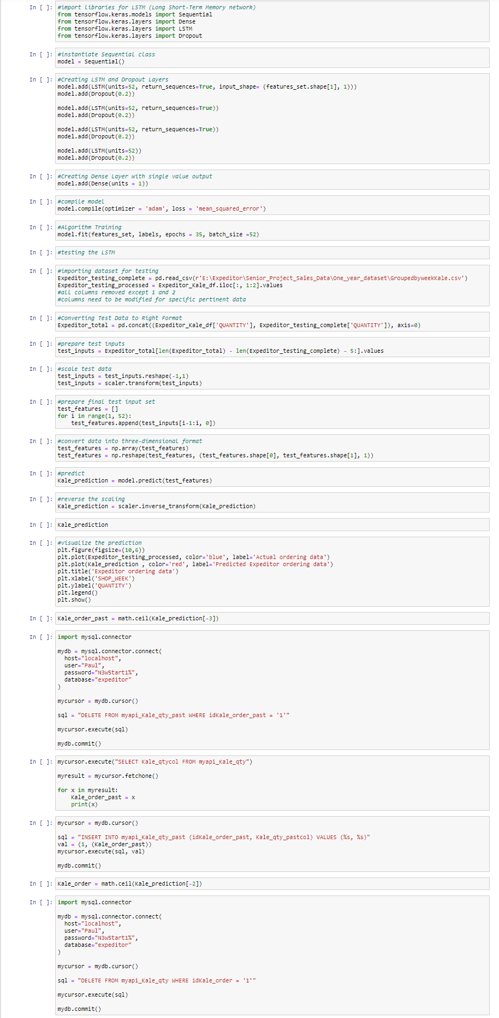
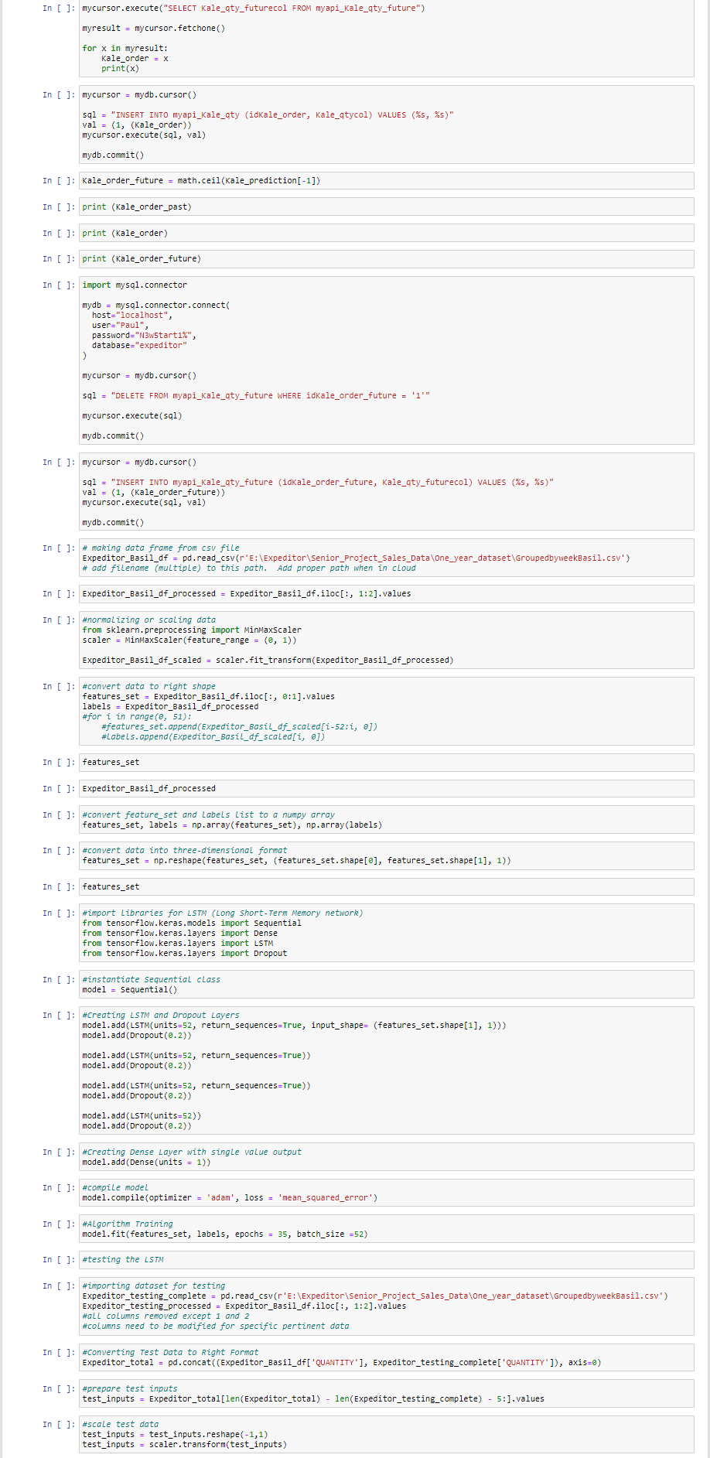
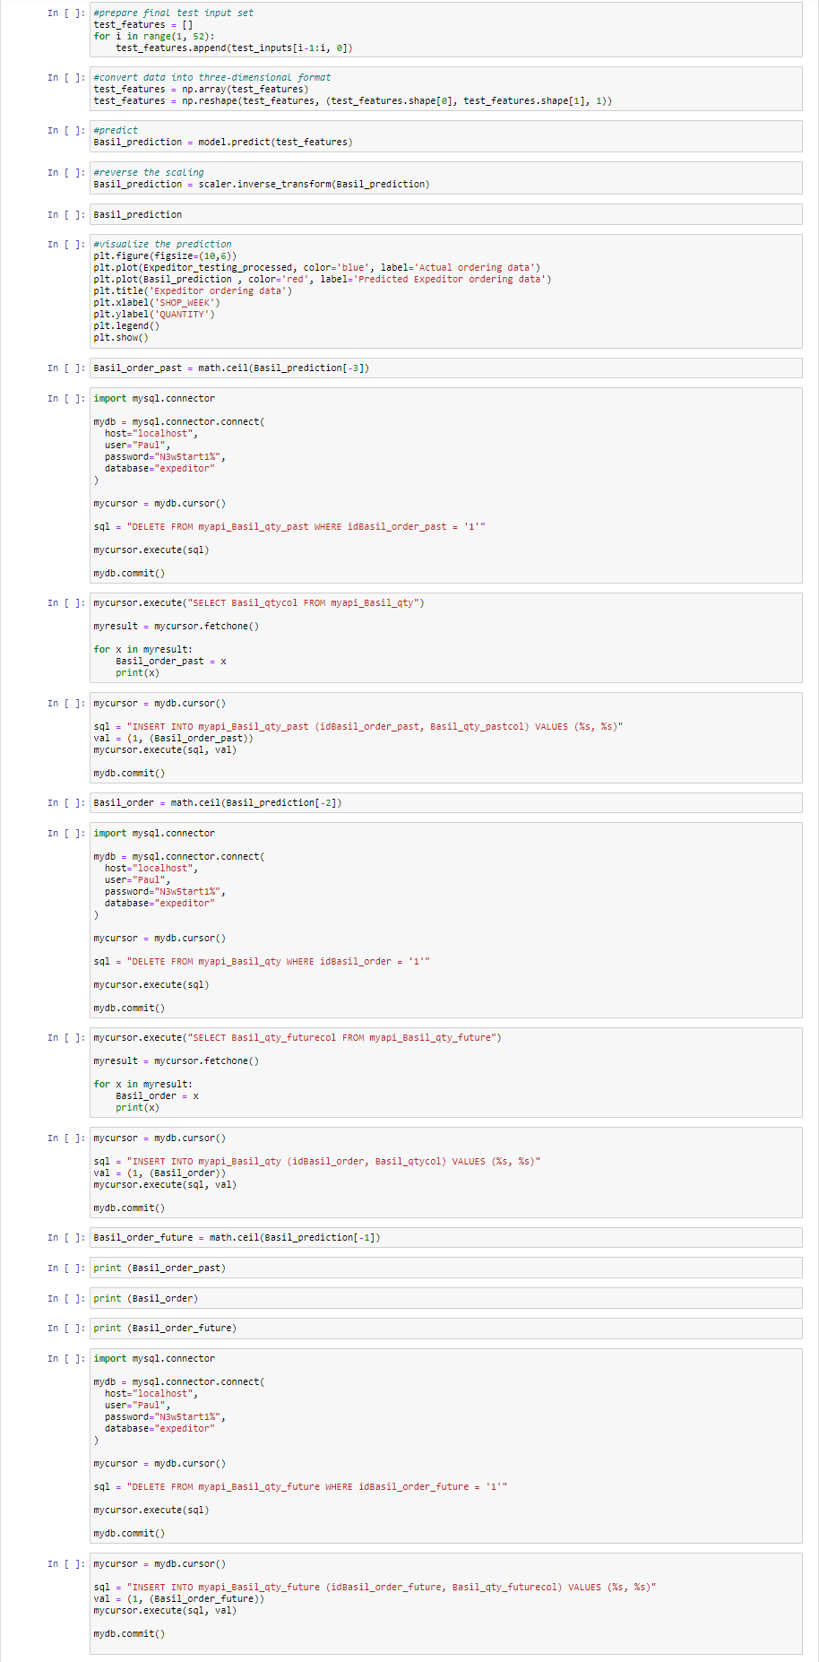
Step 1: The AI Expeditor Script
Written in Tensorflow environment in Python language with the Tensorflow and Keras libraries. Displayed in Jupyter Notebook. Uses a Long Short-Term Memory (LSTM) predictive recurrent neural network.
The script reads in an adapted 52-week sales data dunnhumby “Let’s Get Sort-of-Real” dummy supermarket sales dataset. https://www.dunnhumby.com/source-files/
For three products (Romaine, Kale, and Basil), the script interfaces with mysql, predicts a sales order quantity, writes it to the ‘future order’ table, rewrites previous future order to ‘current order’ table, and rewrites current order to ‘past order’ table.

Slide 9
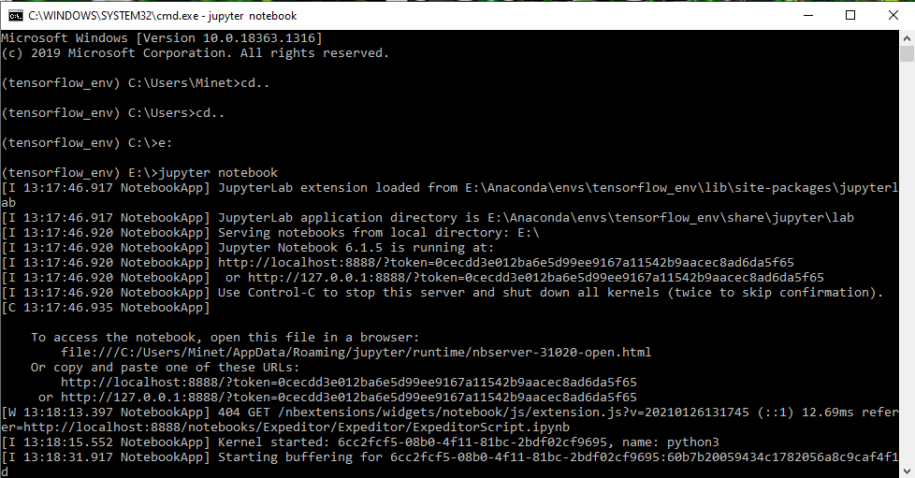
Tensorflow environment Jupyter Notebook cmd interface

Slide 10
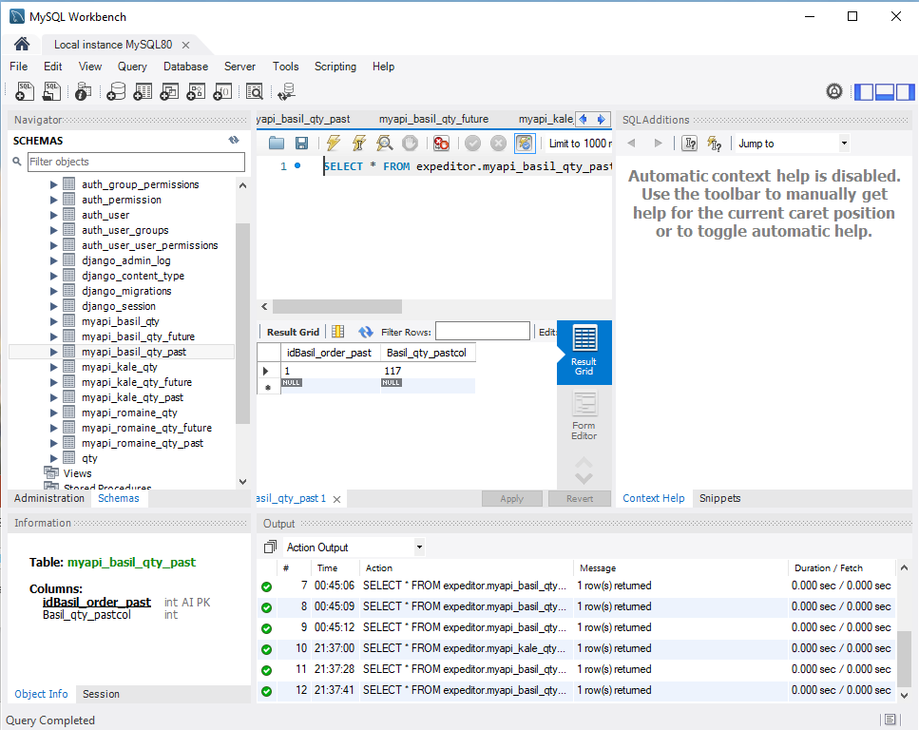
Step 2: The Expeditor Database
Interfaces with the Expeditor Script for predictive input and Django REST Framework for API transactions. Will contain tables for Vertical Farm data and Transport data in coming builds.

Slide 11
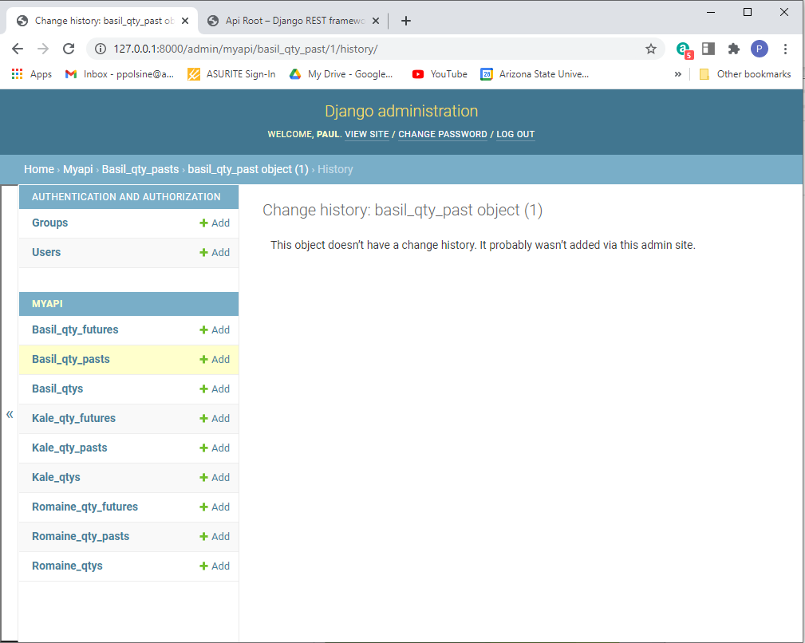
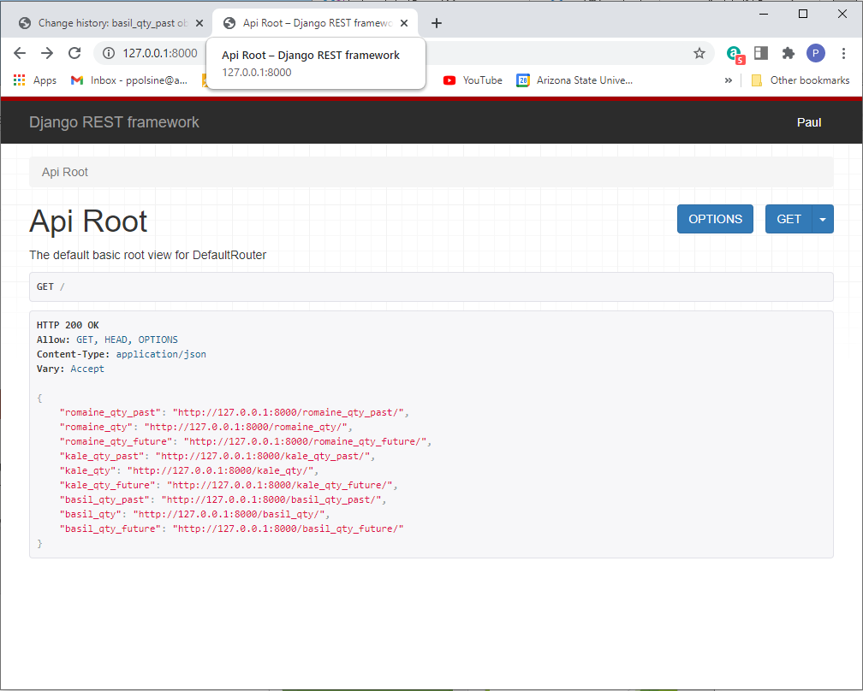
Step 3: Django Rest Framework
Interfaces with the Expeditor Database. It incorporates the Expeditor Supermarket and Restaurant User Interface within its framework and interacts with the HTML, CSS, and JS code through specialized coding interfaces.
Continued on next slide…

Slide 12
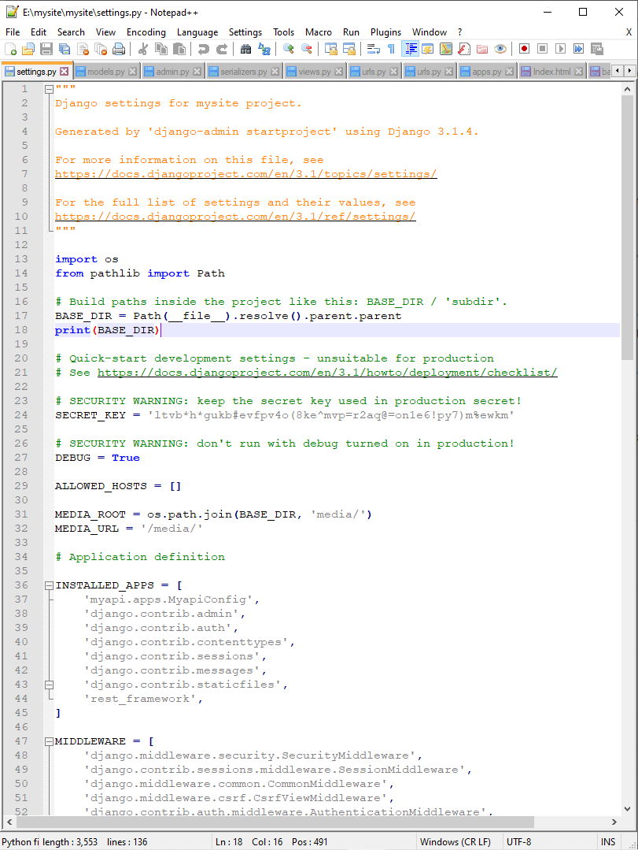
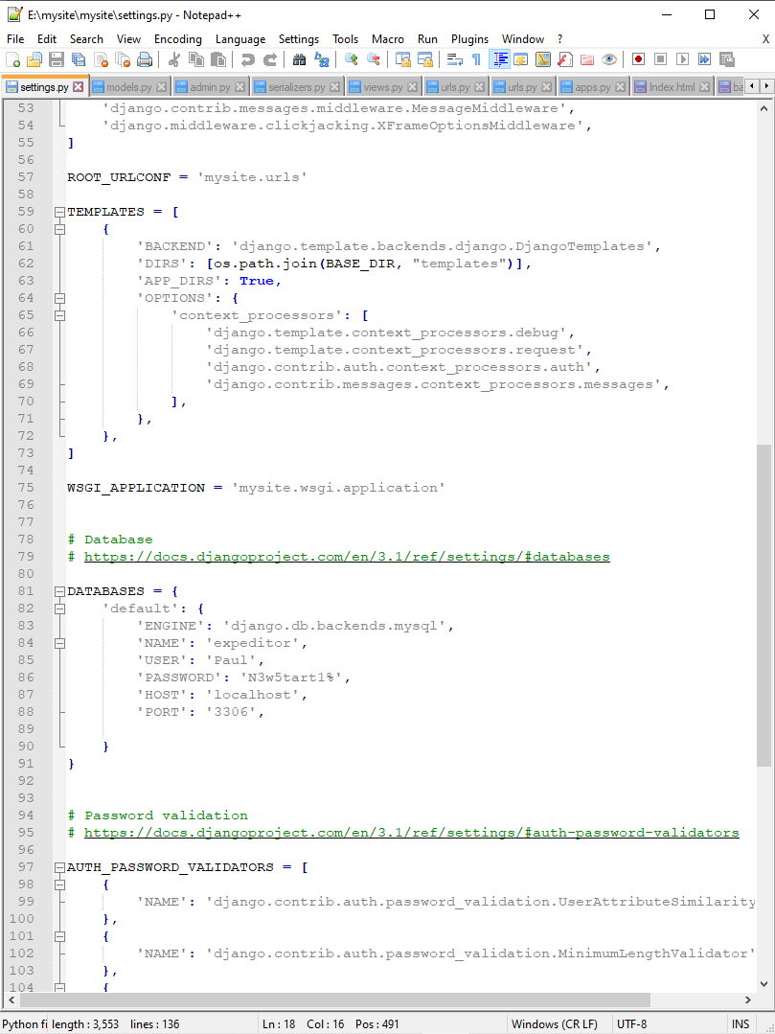
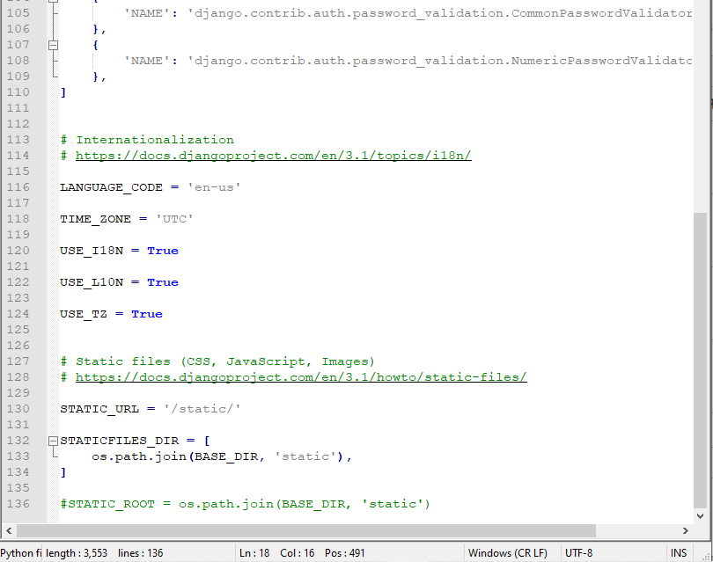
Step 3 continued: settings.py
Django settings.py file is the main file that creates the app that interfaces with the database, defines the database, connects to HTML templates, CSS, JS, and media files.

Slide 13
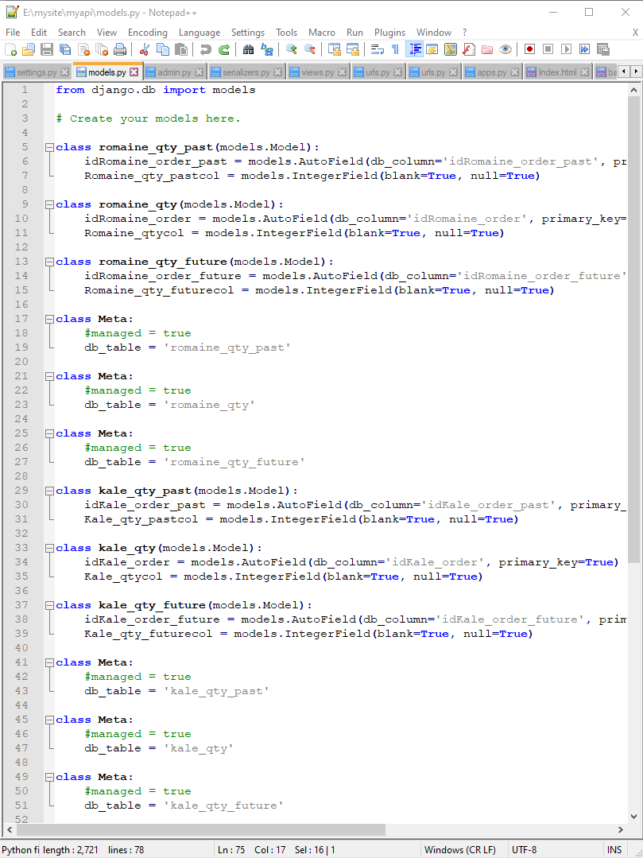
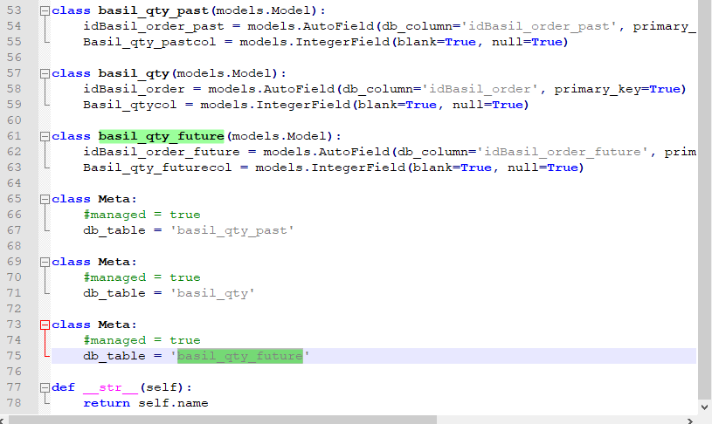
Step 3 continued: models.py
Django models.py file defines the db tables from the settings.py defined db within the Django REST Framework.

Slide 14
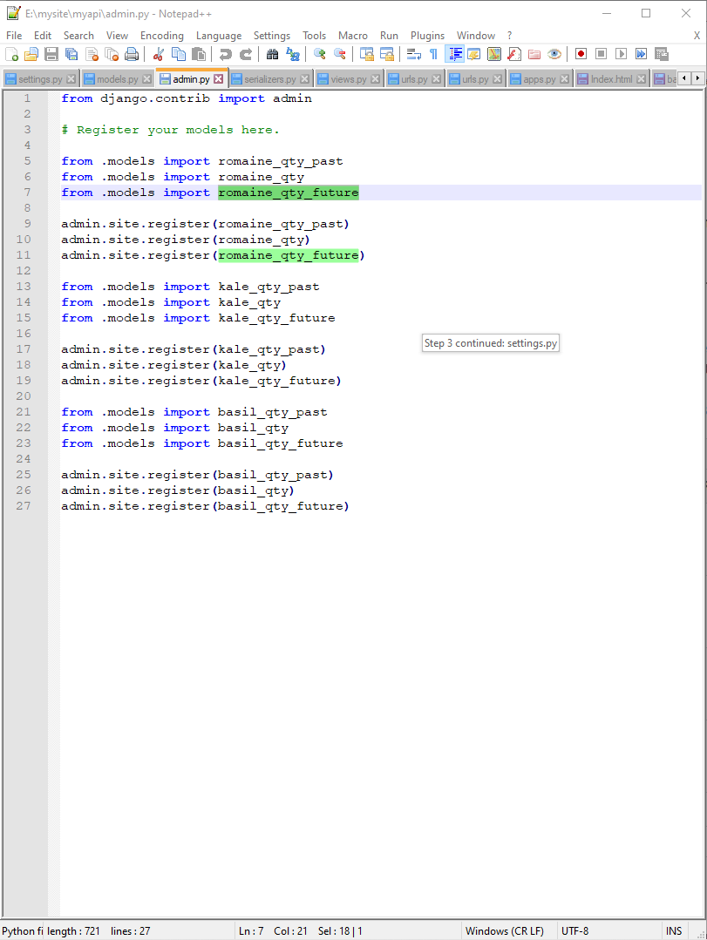
Step 3 continued: admin.py
Django admin.py registers the tables from models.py with Django administration so they may be acted upon within the framework.

Slide 15
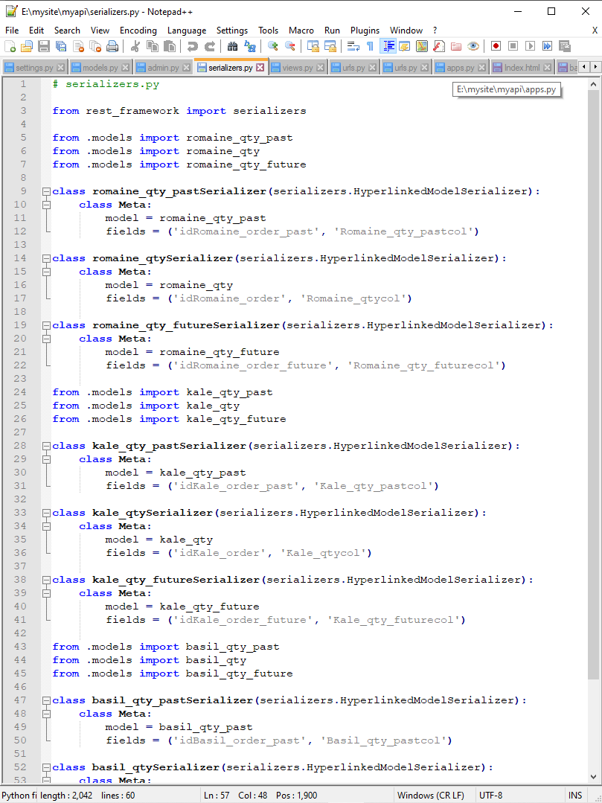
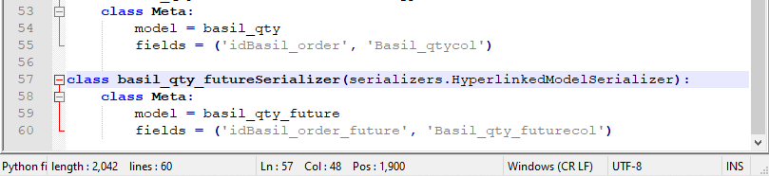
Step 3 continued: serializers.py
Django serializers.py connects and transforms the data in the tables into encapsulated json files.

Slide 16
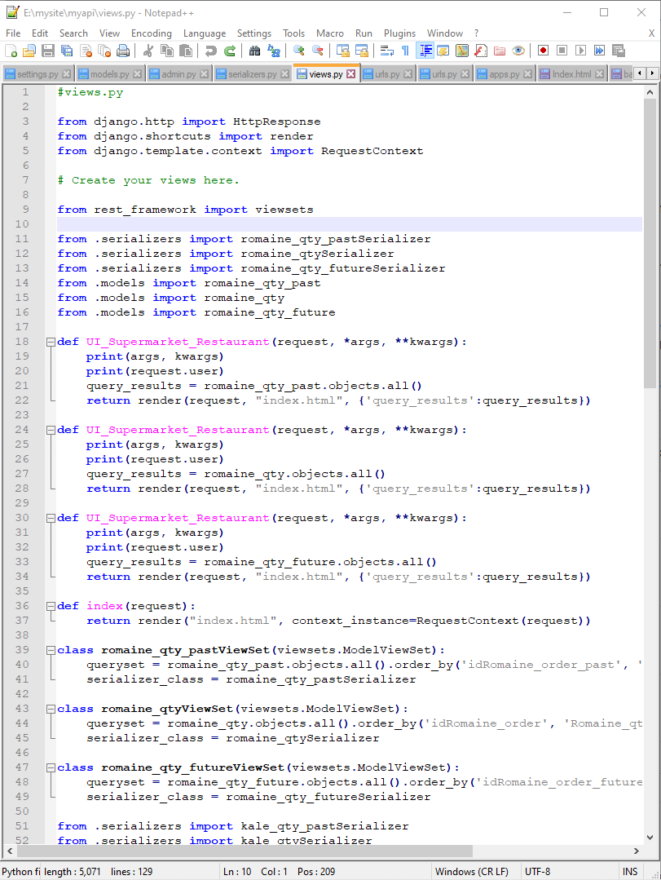
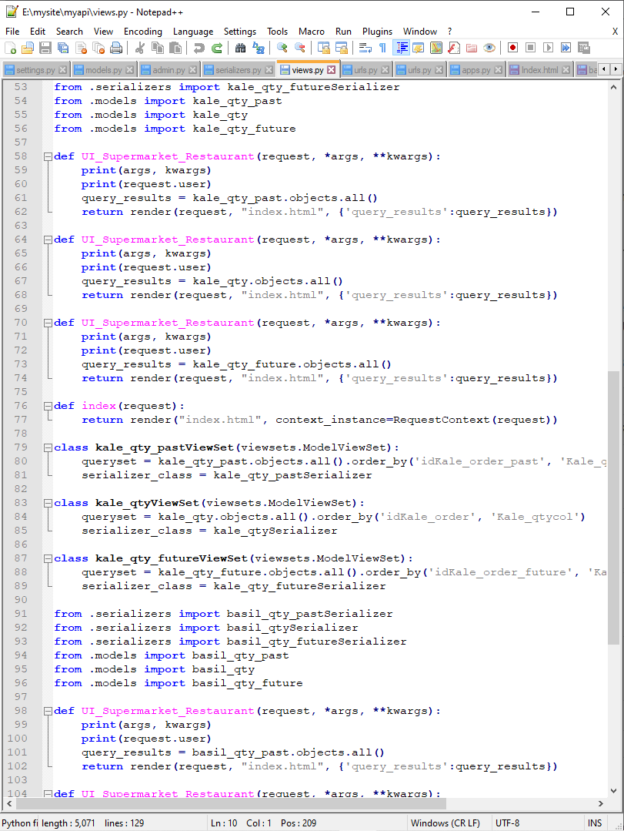
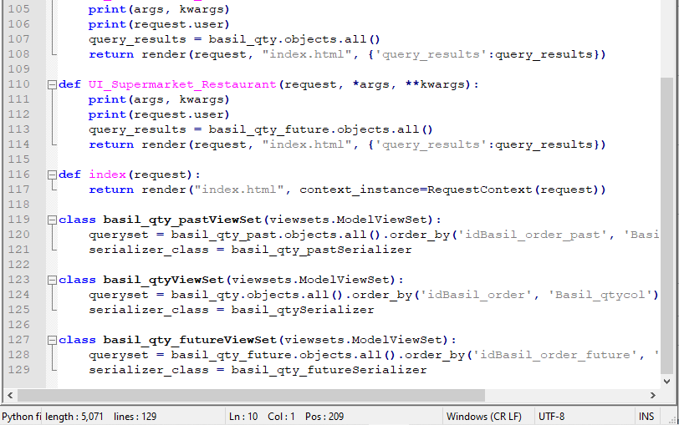
Step 3 continued: views.py
Djano views.py creates the functions that render the json data files into the UI tables.

Slide 17
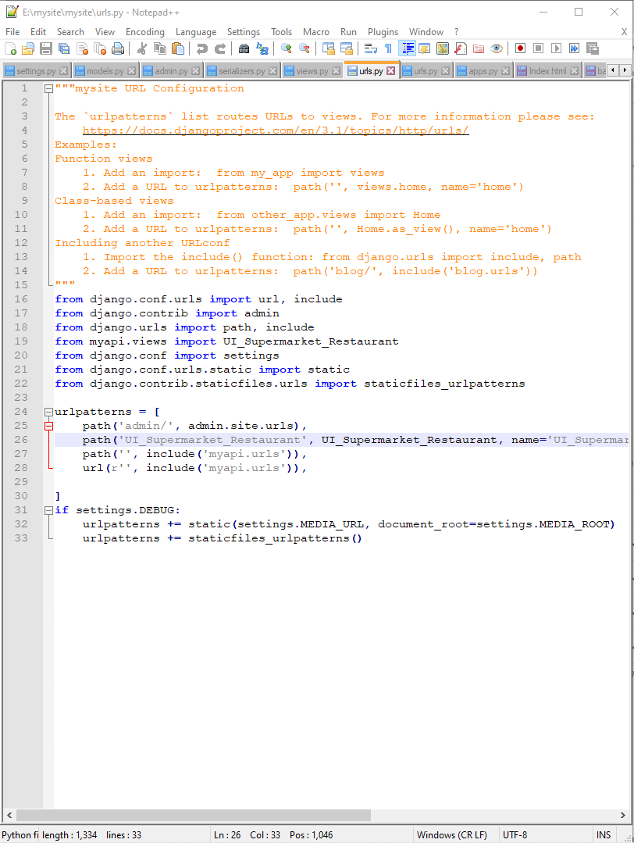
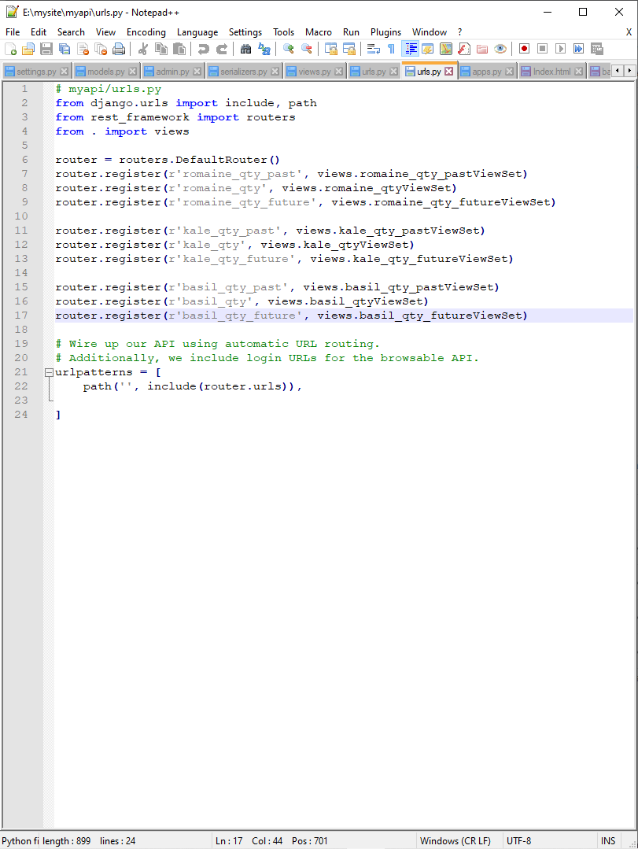
Step 3 continued: urls.py
There are two urls.py in Django REST framework that concern themselves with routing the data between the DB and the UI.

Slide 18
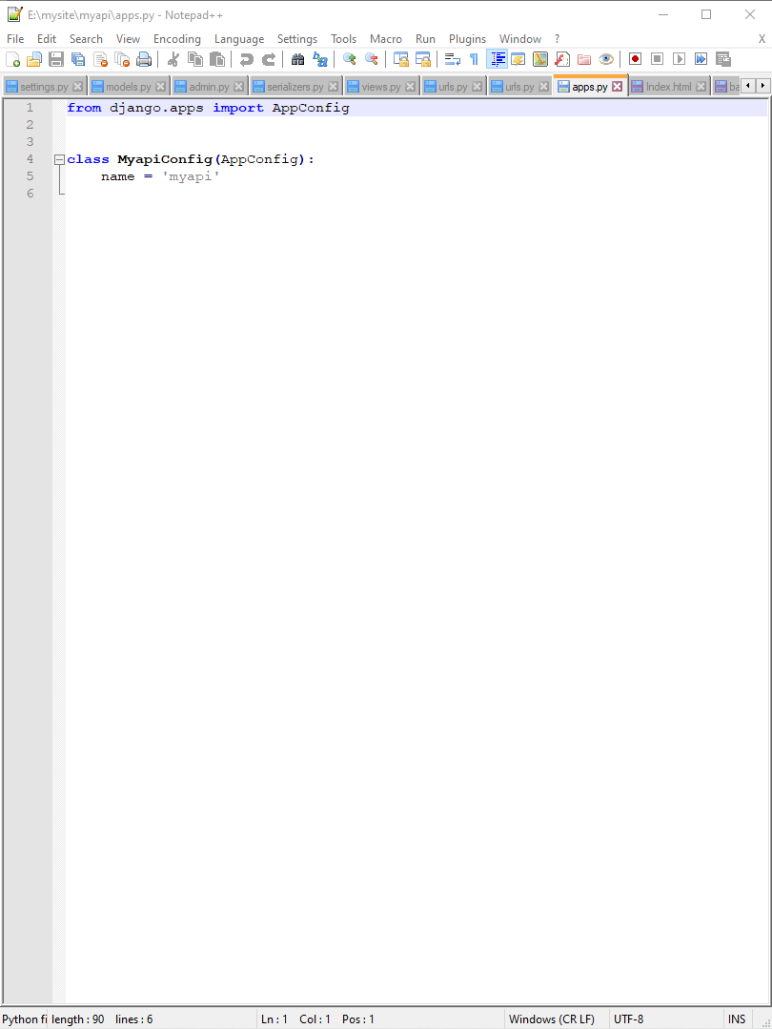
Step 3 continued: apps.py
Django apps.py holds the information about the apps created by settings.py.

Slide 19
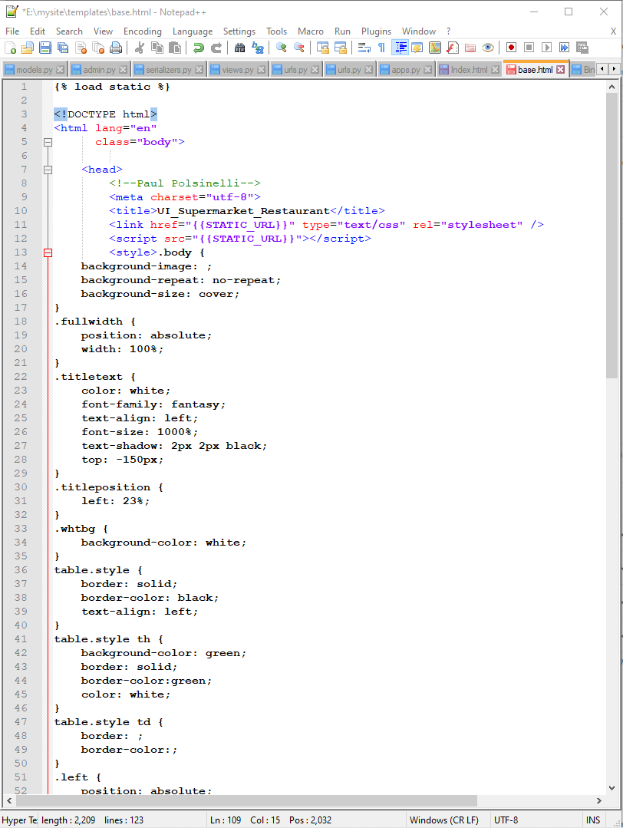
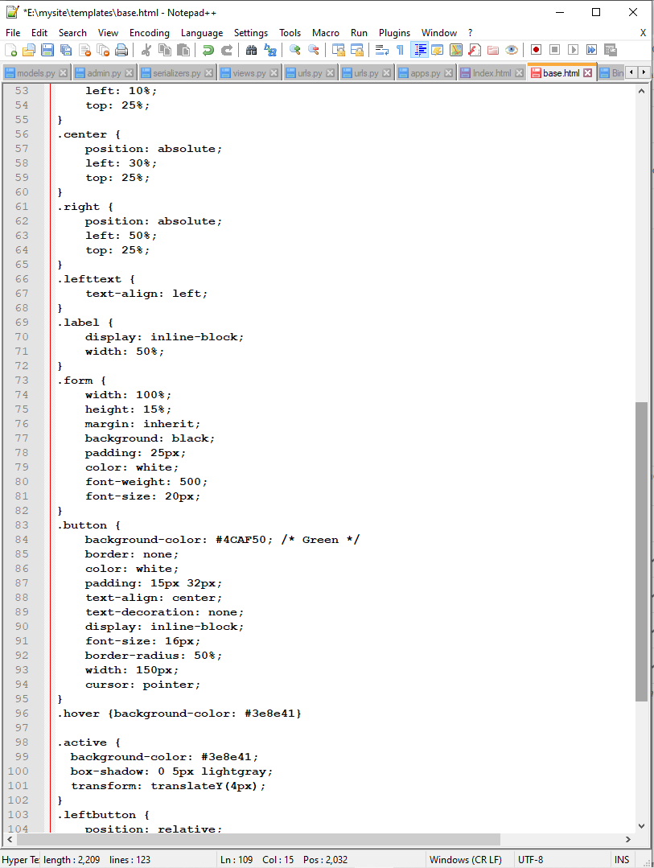
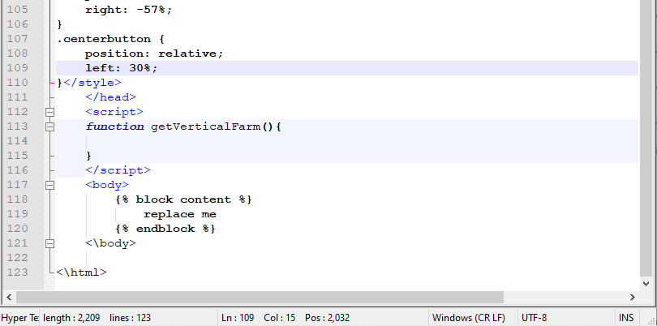
Step 2 continued: base.html
The main HTML file within the Django framework that holds the metadata and contains the connective code to the body and static files.

Slide 20
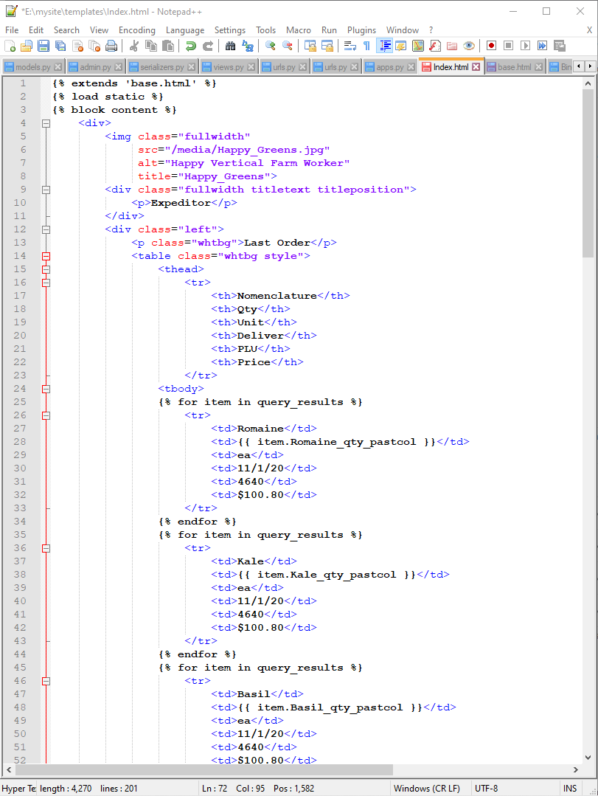
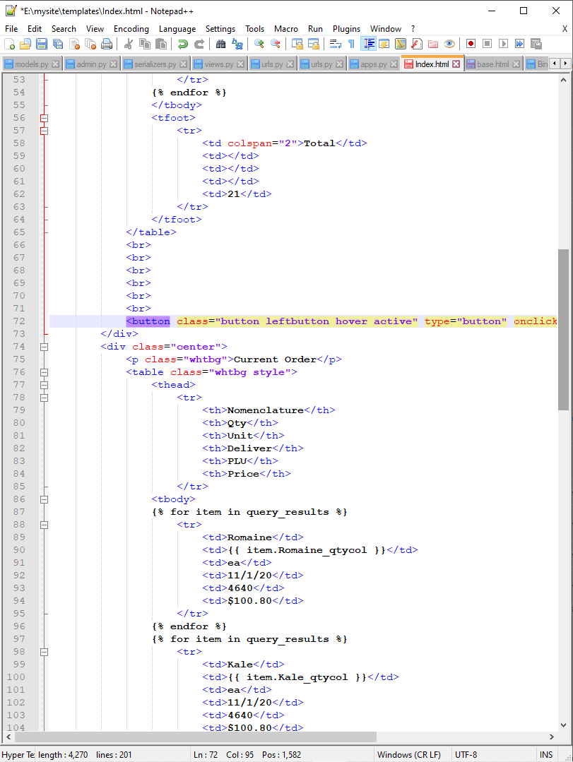
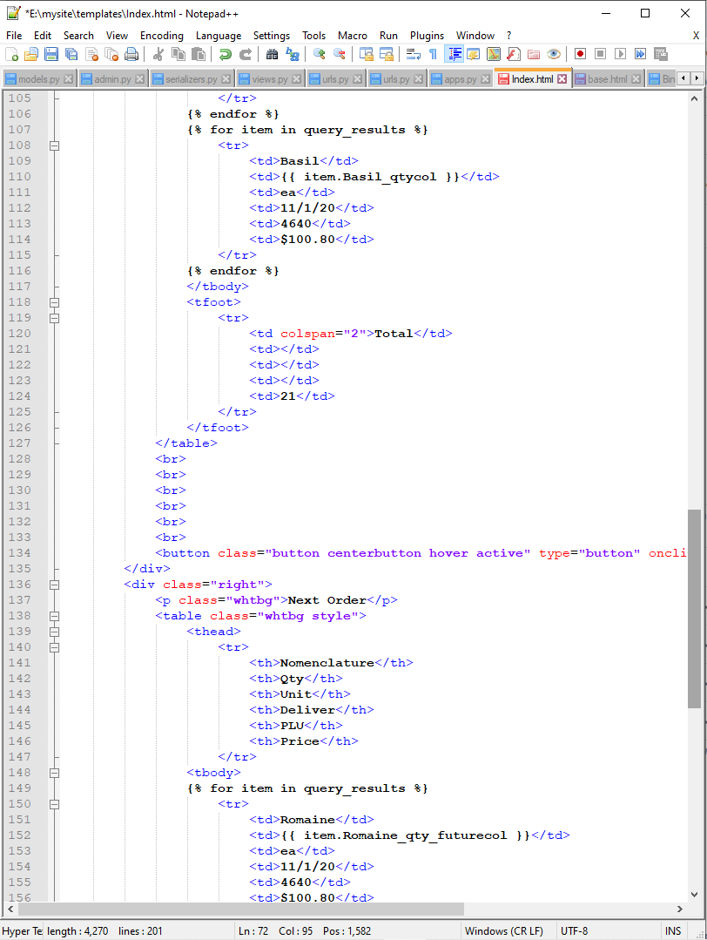
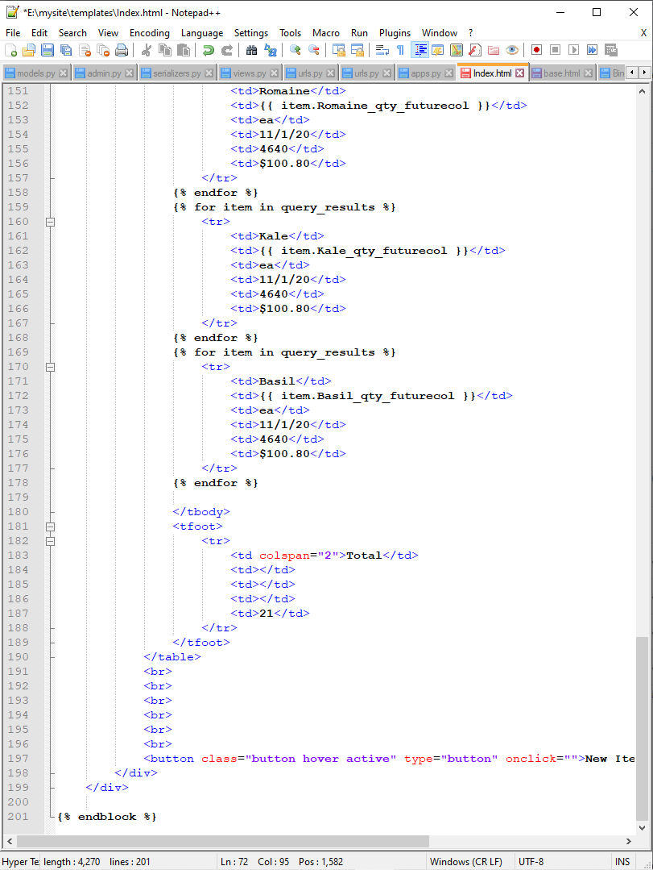
Step 3 continued: Index.html
The Django file that holds the body of the html code and connects to base.html.

Slide 21
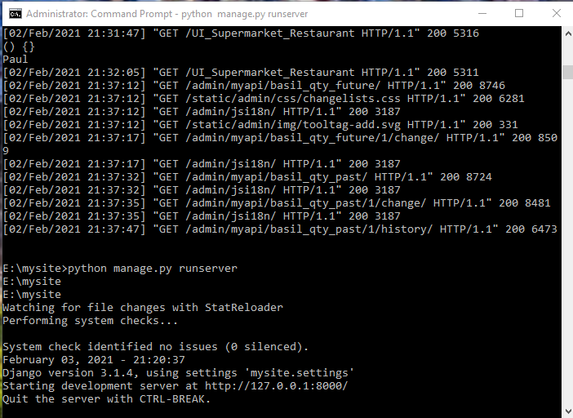
Django server cmd interface

Slide 22
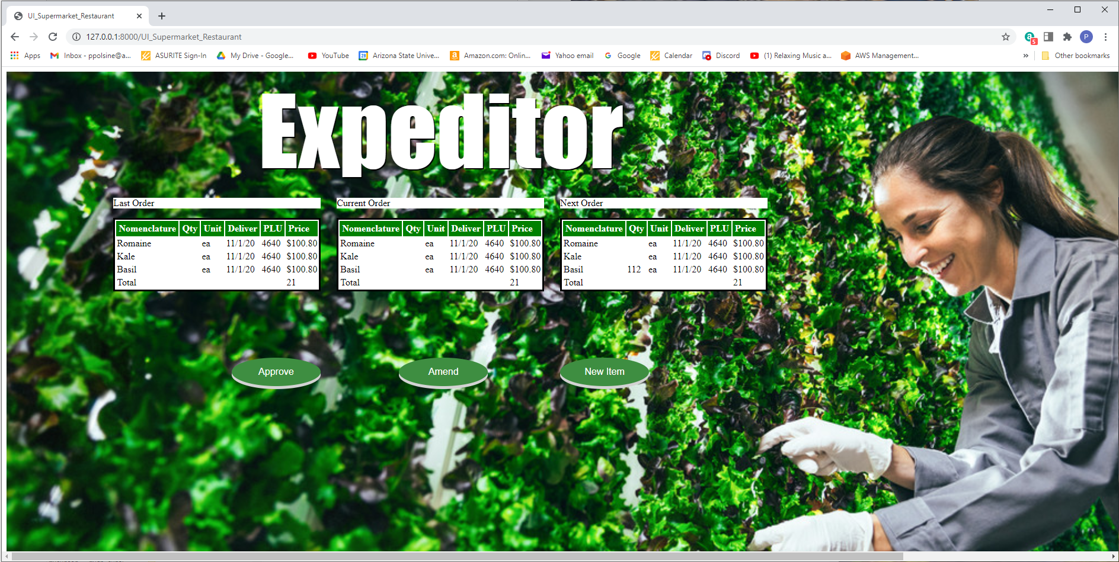
Step 4: Supermarket and Resturant UI

Slide 23
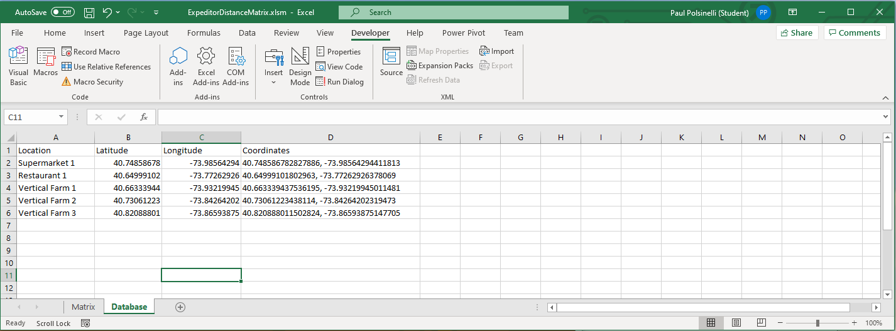
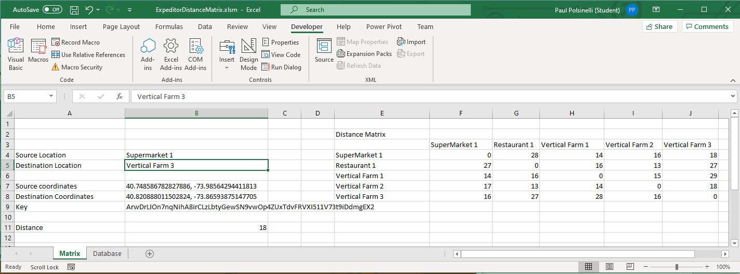
Step 5: Distance Matrix
Calculates the distance between the producers and suppliers

Slide 24
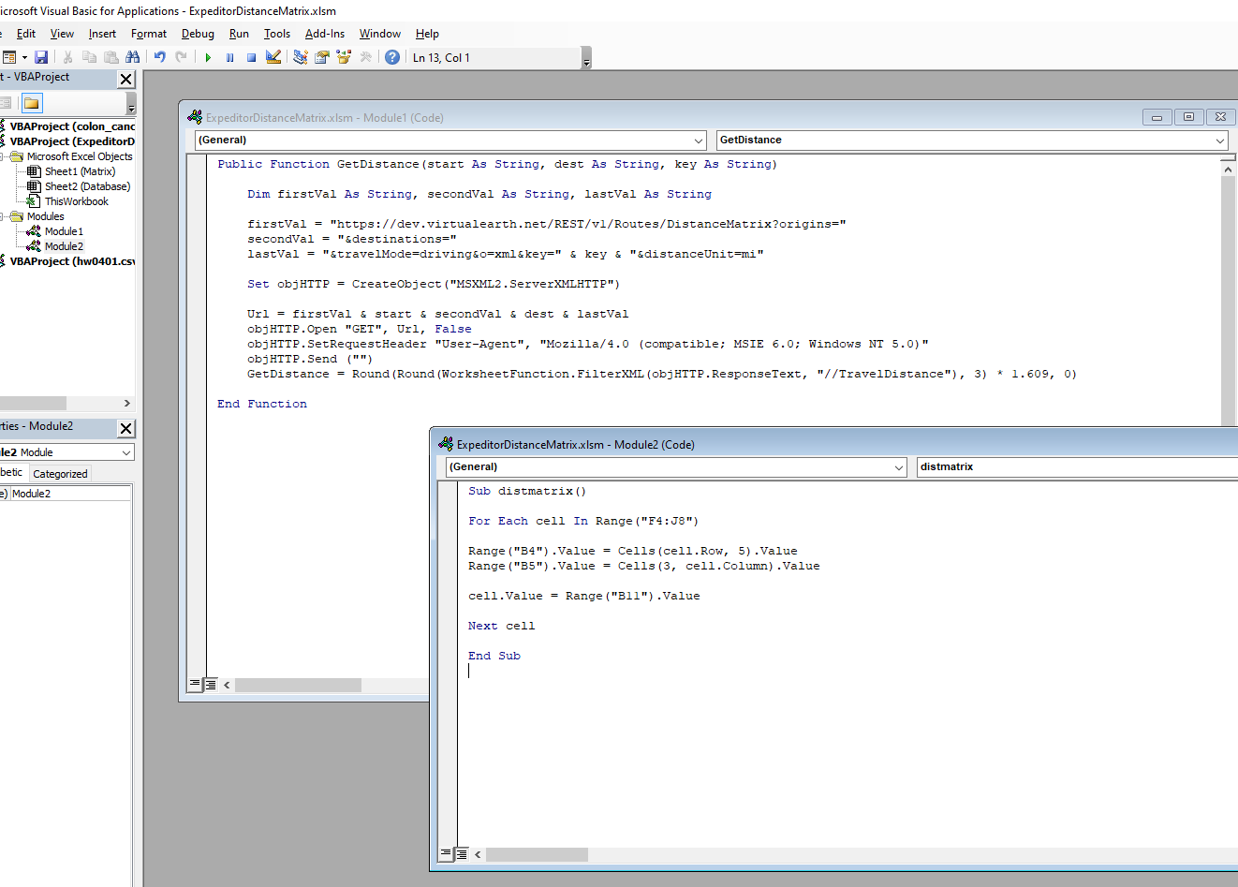
Visual Basic for Applications code for distance matrix
Code to utilize the Bing Maps API and to populate the distance matrix

Slide 25

Problems

Slide 26
Fixed Issues
I began work the day after my last final in December. The problems were persistent from the beginning. The very first issue was installing all the necessary software and packages and their compatibility. Information on how to do this properly was scattered and often conflicting. Once this was resolved, having the dataset of 40.7 GB presented the next problem. Simply trying to view it to understand what to do with it caused my main drive to fill to capacity and crash after several hours of it attempting to process it in Excel. One solution was found but it was expensive. Eventually, after I had to transfer all of my relevant software and installs to a secondary drive with the capacity, it still crashed Excel. Further research gave me a way to delete unnecessary columns without opening the files and I could begin work in earnest.
I eventually further pared down the data to just a few columns and then was able to read it into my code. The code, pieced together and understood through dozens of tutorials and searches, began to make sense and my wife/advisor helped me with the final parameters to get it working. I cannot claim to have an in-depth understanding of it, but enough so to understand step by step what it is doing and manipulate it enough to get satisfactory results.
Somehow, after transferring sqlserver to the new drive, with a completely built out original db design, I rendered it inoperable. Once I had given up on fixing it, I installed mysql and thankfully the learning curve was minimal. I went back to my AI code and learned how to transfer the outputs into the database in the manner I desired. At this point I had my UI built and wanted to populate my tables. However, my initial understanding of API’s and the availability of prebuilt ones, proved to be mistaken. A lot more research revealed to me that I would need to learn Django Rest Framework, which was not a simple task.
Slowly, I pieced together the knowledge and skills to transfer the relevant db field into at least one of my table fields. I am still working on the problem of getting all fields transferred. Though it seems like it should be a simple enough task given my progress, it has proved otherwise.
Not knowing how to calculate distances to choose which supplier the system should select, more research gave me the answer and I created a distance matrix in Excel. This is where I stand today.

Slide 27

Outstanding Issues
The biggest current problem is populating my tables in the UI and has thoroughly vexed me after going over all the Django code with a fine-toothed comb multiple times and researching dozens of web pages for answers. My next step is to directly ask the Stack Overflow community for help. I feel in the end it will be simple and obvious in retrospect. Concurrently, I will work on the coding and data transfer details of selecting a supplier to match customer demand.

Slide 28

What’s next?
Build 2 will see the supply data flow and transportation aspects of the project solved and implemented. This will involve some python code in Django, new table construction in mysql, and possibly more VB code.
Build 2 will also see the UI table population problem solved.
If these two tasks are solved in due time, I will reconsider whether or not to operate this from AWS due to cost and data considerations.

